Slide 1
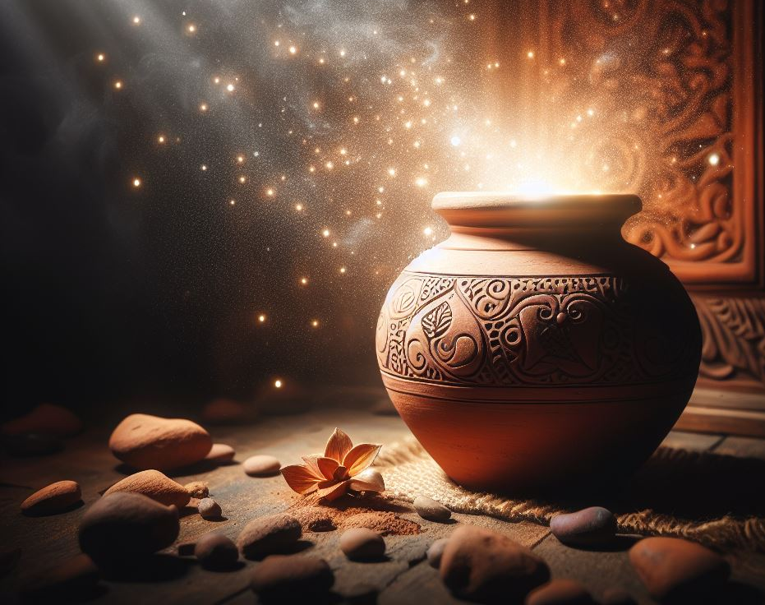
BEING A LIGHT IN THE DARKNESS
STEPPING INTO OUR PURPOSE AS SONS AND DAUGHTERS OF THE LIVING GOD

Slide 2
2 Corinthians 4:5-14 ESV
5 For what we proclaim is not ourselves, but Jesus Christ as Lord, with ourselves as your servants for Jesus' sake. 6 For God, who said, “Let light shine out of darkness,” has shone in our hearts to give the light of the knowledge of the glory of God in the face of Jesus Christ.
Treasure in Jars of Clay
7 But we have this treasure in jars of clay, to show that the surpassing power belongs to God and not to us. 8 We are afflicted in every way, but not crushed; perplexed, but not driven to despair; 9 persecuted, but not forsaken; struck down, but not destroyed; 10 always carrying in the body the death of Jesus, so that the life of Jesus may also be manifested in our bodies. 11 For we who live are always being given over to death for Jesus' sake, so that the life of Jesus also may be manifested in our mortal flesh. 12 So death is at work in us, but life in you.
13 Since we have the same spirit of faith according to what has been written, “I believed, and so I spoke,” we also believe, and so we also speak, 14 knowing that he who raised the Lord Jesus will raise us also with Jesus and bring us with you into his presence.

Slide 3
Surviving in troubled times
a. What is your definition of surviving?
John 10:10 ESV
10 The thief comes only to steal and kill and destroy. I came that they may have life and have it abundantly.
i. Matthew 24:13-14 ESV
13 But the one who endures to the end will be saved. 14 And this gospel of the kingdom will be proclaimed throughout the whole world as a testimony to all nations, and then the end will come.
ii. The fullness of the gentiles

Slide 4
Expectant faith
Knowing, not begging
Fighting with love. Taking down strongholds one at a time
Vigilance, not new prophecy. Conditions of the world are becoming apparent.
Matthew 24: 6 ESV
6 And you will hear of wars and rumors of wars. See that you are not alarmed, for this must take place, but the end is not yet.

Slide 5
e. Taking down false gods with the gospel using faith and truth.
1 Corinthians 13:1-6 ESV
The Way of Love
13 If I speak in the tongues of men and of angels, but have not love, I am a noisy gong or a clanging cymbal. 2 And if I have prophetic powers, and understand all mysteries and all knowledge, and if I have all faith, so as to remove mountains, but have not love, I am nothing. 3 If I give away all I have, and if I deliver up my body to be burned, but have not love, I gain nothing.
4 Love is patient and kind; love does not envy or boast; it is not arrogant 5 or rude. It does not insist on its own way; it is not irritable or resentful; 6 it does not rejoice at wrongdoing, but rejoices with the truth.

Slide 6
The battlefield is in the hearts and minds.
Exodus 20: 3 ESV
3 “You shall have no other gods before me.”
Mark 12: 28-31 ESV
The Great Commandment
28 And one of the scribes came up and heard them disputing with one another, and seeing that he answered them well, asked him, “Which commandment is the most important of all?” 29 Jesus answered, “The most important is, ‘Hear, O Israel: The Lord our God, the Lord is one. 30 And you shall love the Lord your God with all your heart and with all your soul and with all your mind and with all your strength.’ 31 The second is this: ‘You shall love your neighbor as yourself.’ There is no other commandment greater than these.”

Slide 7
Tearing down spiritual strongholds
A spiritual stronghold is the temple of idols/false gods. This is where they are worshipped by us giving our attention and action.
b. Each son and daughter of God must focus on the ones God places in our path. One individual should not focus on the entire world, but if each one of us in the body of Christ were to focus on their individual path with God, we would take on the world!

Slide 8
Christ consciousness, not sin conscious.
We must begin today to change our focus from ourselves and place it on our path and those who cross it!
We must be spiritually oriented not worldly oriented!
We must be Christ conscious in our identity, not sin conscious in our identity!
d. First Peter 2: 9 ESV
9 But you are a chosen race, a royal priesthood, a holy nation, a people for his own possession, that you may proclaim the excellencies of him who called you out of darkness into his marvelous light.
(quoted from Exodus 19: 6)
6 and you shall be to me a kingdom of priests and a holy nation.’ These are the words that you shall speak to the people of Israel.”

Slide 9
My recent experiences in the last two weeks:
1 Timothy 2: 1-4
Pray for All People
2 First of all, then, I urge that supplications, prayers, intercessions, and thanksgivings be made for all people, 2 for kings and all who are in high positions, that we may lead a peaceful and quiet life, godly and dignified in every way. 3 This is good, and it is pleasing in the sight of God our Savior, 4 who desires all people to be saved and to come to the knowledge of the truth.

Slide 10
A household of believers under attack. They wait and pray for help.
The daughter
Healing at home and in the hospital. Stroke symptoms disappear with prayer.
The elderly mother praying and fateful in discernment.
The young boy is under attack by demons and being led astray.
Boy hears God's word while intoxicated and still remembers the next day.

Slide 11
b. A 21-year-old believer who committed suicide.
Praying with his father to strengthen him for his family.
Testifying to everyone involved of the importance of the hour.
Calling evil, evil and proclaiming the goodness of God.
Speaking truth in the darkness. God did not want this or allow this.
Victims of evil.
Beauty for ashes. Isaiah 61: 3 ESV
3 to grant to those who mourn in Zion—
to give them a beautiful headdress instead of ashes,
the oil of gladness instead of mourning,
the garment of praise instead of a faint spirit;
that they may be called oaks of righteousness,
the planting of the Lord, that he may be glorified.
We must offer ashes to God to receive the beauty from the circumstances.
Ashes represent repentance and mourning.

Slide 12
Conclusion:
Let us take to heart the words of scripture and the example of our savior as we embark on this journey of fighting with love. May our actions be guided by love, our words be seasoned with grace, and our hearts be filled with compassion for all. As we stand united in the love of Christ, let us bring about a transformation that transcends barriers, unites hearts, and glorifies the name of our Lord. Let us, therefore, examine our hearts and minds to identify any false gods that have taken root within us, so that we may then identify those in others. Let us earnestly seek the guidance of the Holy Spirit to help us discern what is truly valuable and worthy of Our Attention and actions, which is our worship. May we have the courage to confront and dismantle these false gods, surrendering ourselves completely to the will of our heavenly father. Let us pray for the strength and wisdom to resist the allure of false gods and remain faithful to the one true God. May we be inspired by the example of the apostles and follow in their footsteps, boldly proclaiming the truth of the gospel and leading others to the light of Christ. Let us commit ourselves to the journey of tearing down spiritual strongholds in our lives and in the lives of others. May we be inspired by the example of Jesus and the promises of scripture as we press forward in faith and obedience. Together, let us support one another in love and unity, encouraging one another to walk in the freedom that Christ has won for us. May the peace of God, which surpasses all understanding, guard our hearts and minds in Christ Jesus (Philippians 4: 7). May we be strengthened by his grace and empowered by his spirit to overcome every obstacle in our path.

