Slide 1
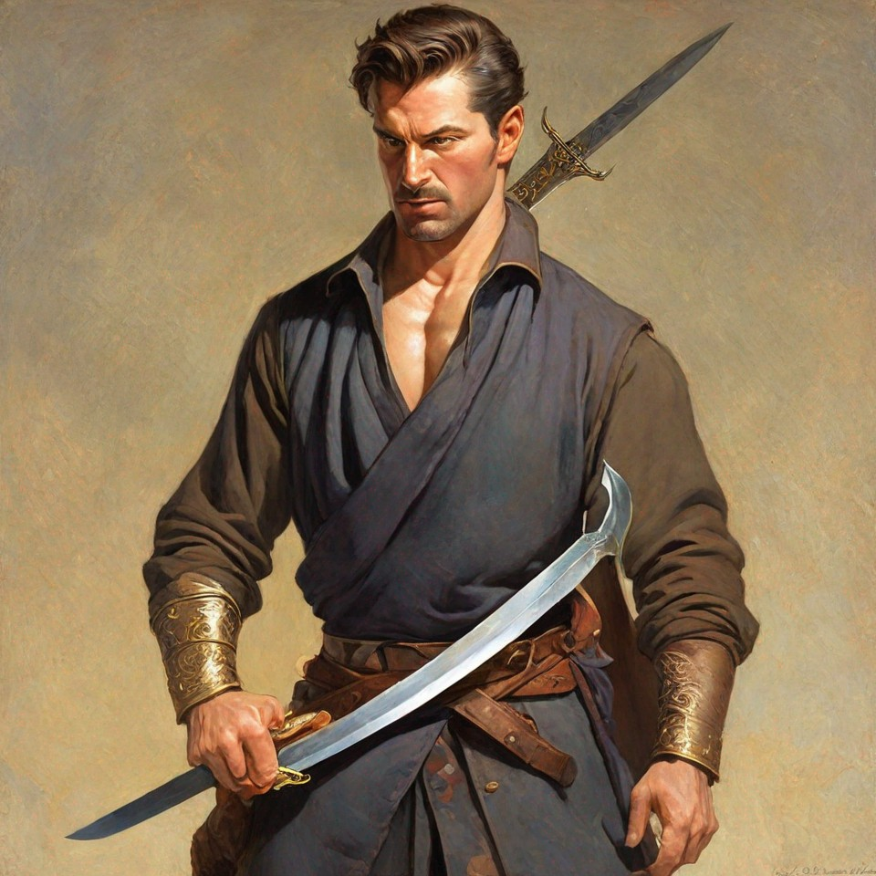
Dealing With Specific Diseases: Use Your Weapon to Counter a Fear and Anxiety Attack!
With Bishop Ronald K. Powell

Slide 2
Introduction

Slide 3
1 Thessalonians 5:23
And the very God of peace sanctify you wholly; and I pray God your whole spirit and soul and body be preserved blameless unto the coming of our Lord Jesus Christ.

Slide 4
Hebrews 4:12
And the very God of peace sanctify you wholly; and I pray God your whole spirit and soul and body be preserved blameless unto the coming of our Lord Jesus Christ.

Slide 5
Matthew 4:4
4 But he answered and said, It is written, Man shall not live by bread alone, but by every word that proceedeth out of the mouth of God.

Slide 6
Matthew 4:7
7 Jesus said unto him, It is written again, Thou shalt not tempt the Lord thy God.

Slide 7
MATTHEW 4:10
10 Then saith Jesus unto him, Get thee hence, Satan: for it is written, Thou shalt worship the Lord thy God, and him only shalt thou serve.

Slide 8
Romans 10:17
17 So then faith cometh by hearing, and hearing by the word of God.

Slide 9
Matthew 16:19
19 And I will give unto thee the keys of the kingdom of heaven: and whatsoever thou shalt bind on earth shall be bound in heaven: and whatsoever thou shalt loose on earth shall be loosed in heaven.

Slide 10
2 Timothy 1:7
7 For God hath not given us the spirit of fear; but of power, and of love, and of a sound mind.

Slide 11
1 Peter 5:7
7 Casting all your care upon him; for he careth for you.

Slide 12
Philippians 4:6–7
6 Be careful for nothing; but in everything by prayer and supplication with thanksgiving let your requests be made known unto God. 7 And the peace of God, which passeth all understanding, shall keep your hearts and minds through Christ Jesus.

Slide 13
John 14:27
27 Peace I leave with you, my peace I give unto you: not as the world giveth, give I unto you. Let not your heart be troubled, neither let it be afraid.

Slide 14
Proverbs 29:25
25 The fear of man bringeth a snare: But whoso putteth his trust in the Lord shall be safe.

Slide 15
Hebrews 13:5
5 Let your conversation be without covetousness; and be content with such things as ye have: for he hath said, I will never leave thee, nor forsake thee.

Slide 16
Hebrews 13:6
6 So that we may boldly say, The Lord is my helper, and I will not fear what man shall do unto me.

Slide 17
Psalm 27:1
1 The Lord is my light and my salvation; whom shall I fear?
The Lord is the strength of my life; of whom shall I be afraid?

Slide 18
Isaiah 41:10
10 Fear thou not; for I am with thee:
Be not dismayed; for I am thy God:
I will strengthen thee; yea, I will help thee;
Yea, I will uphold thee with the right hand of my righteousness.

Slide 19
Joshua 1:9
9 Have not I commanded thee? Be strong and of a good courage; be not afraid, neither be thou dismayed: for the Lord thy God is with thee whithersoever thou goest.

Slide 20
1 John 4:18
18 There is no fear in love; but perfect love casteth out fear: because fear hath torment. He that feareth is not made perfect in love.

Slide 21
Ephesians 3:16–19
16 That he would grant you, according to the riches of his glory, to be strengthened with might by his Spirit in the inner man; 17 That Christ may dwell in your hearts by faith; that ye, being rooted and grounded in love, 18 May be able to comprehend with all saints what is the breadth, and length, and depth, and height; 19 And to know the love of Christ, which passeth knowledge, that ye might be filled with all the fulness of God.

Slide 22
Exodus 33:13–14
13 Now therefore, I pray thee, if I have found grace in thy sight, shew me now thy way, that I may know thee, that I may find grace in thy sight: and consider that this nation is thy people. 14 And he said, My presence shall go with thee, and I will give thee rest.

Slide 23
Deuteronomy 10:12
12 And now, Israel, what doth the Lord thy God require of thee, but to fear the Lord thy God, to walk in all his ways, and to love him, and to serve the Lord thy God with all thy heart and with all thy soul,

Slide 24
Deuteronomy 13:3
3 Thou shalt not hearken unto the words of that prophet, or that dreamer of dreams: for the Lord your God proveth you, to know whether ye love the Lord your God with all your heart and with all your soul.

Slide 25
2 Corinthians 10:5
5 Casting down imaginations, and every high thing that exalteth itself against the knowledge of God, and bringing into captivity every thought to the obedience of Christ;

Slide 26
Deuteronomy 10:12
12 And now, Israel, what doth the Lord thy God require of thee, but to fear the Lord thy God, to walk in all his ways, and to love him, and to serve the Lord thy God with all thy heart and with all thy soul,

Slide 27
Isaiah 53:5
5 But he was wounded for our transgressions, He was bruised for our iniquities:
The chastisement of our peace was upon him; And with his stripes we are healed.

Slide 28
Psalm 103:3
3 Who forgiveth all thine iniquities;
Who healeth all thy diseases;

Slide 29
1 John 1:9
9 If we confess our sins, he is faithful and just to forgive us our sins, and to cleanse us from all unrighteousness

Slide 30
James 5:14–16
14 Is any sick among you? let him call for the elders of the church; and let them pray over him, anointing him with oil in the name of the Lord: 15 And the prayer of faith shall ^{t}save the sick, and the Lord shall raise him up; and if he have committed sins, they shall be forgiven him. 16 Confess your faults one to another, and pray one for another, that ye may be healed. The effectual fervent prayer of a righteous man availeth much.

Slide 31
Psalm 34:4
4 I sought the Lord, and he heard me, And delivered me from all my fears.

