Slide 1
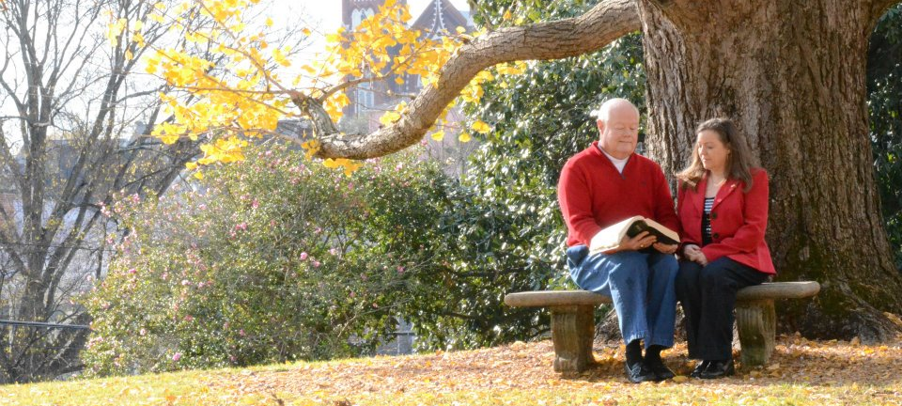
Today's Message: "A Love That Will Last"

